Slide 1
Data Mining 2022 Final Project
Generative Adversarial Network
for Ukiyo-e image generation

Slide 2
Table of contents:
Ukiyo-e
GAN
Deep Convloutional GAN
Conditional GAN
Dataset and issues
Final results
Demo
Future development
Bibliography
Marco Calamo 1808240

Slide 3
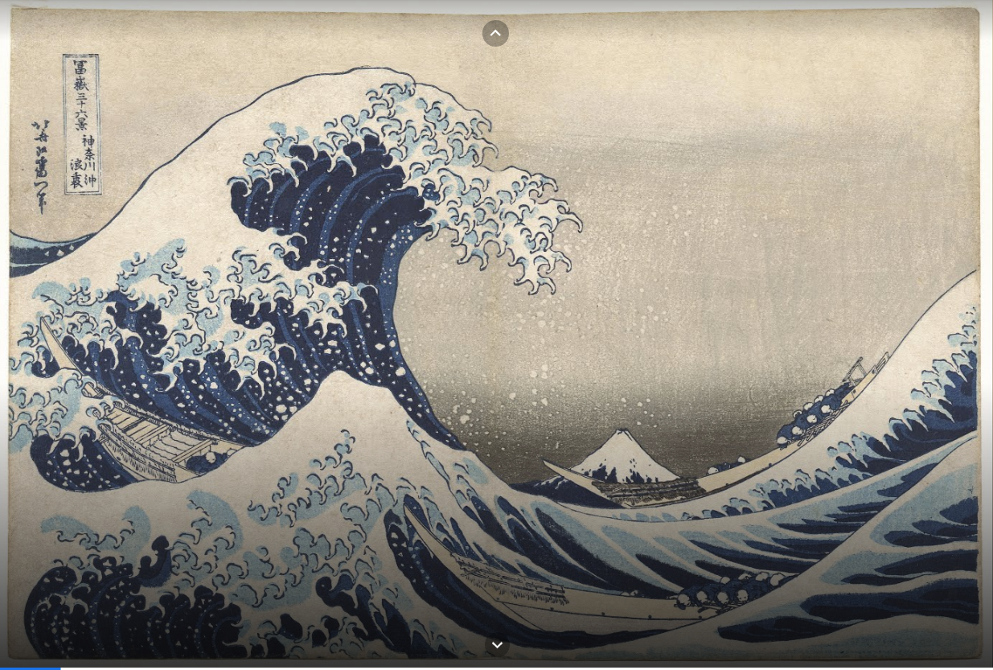
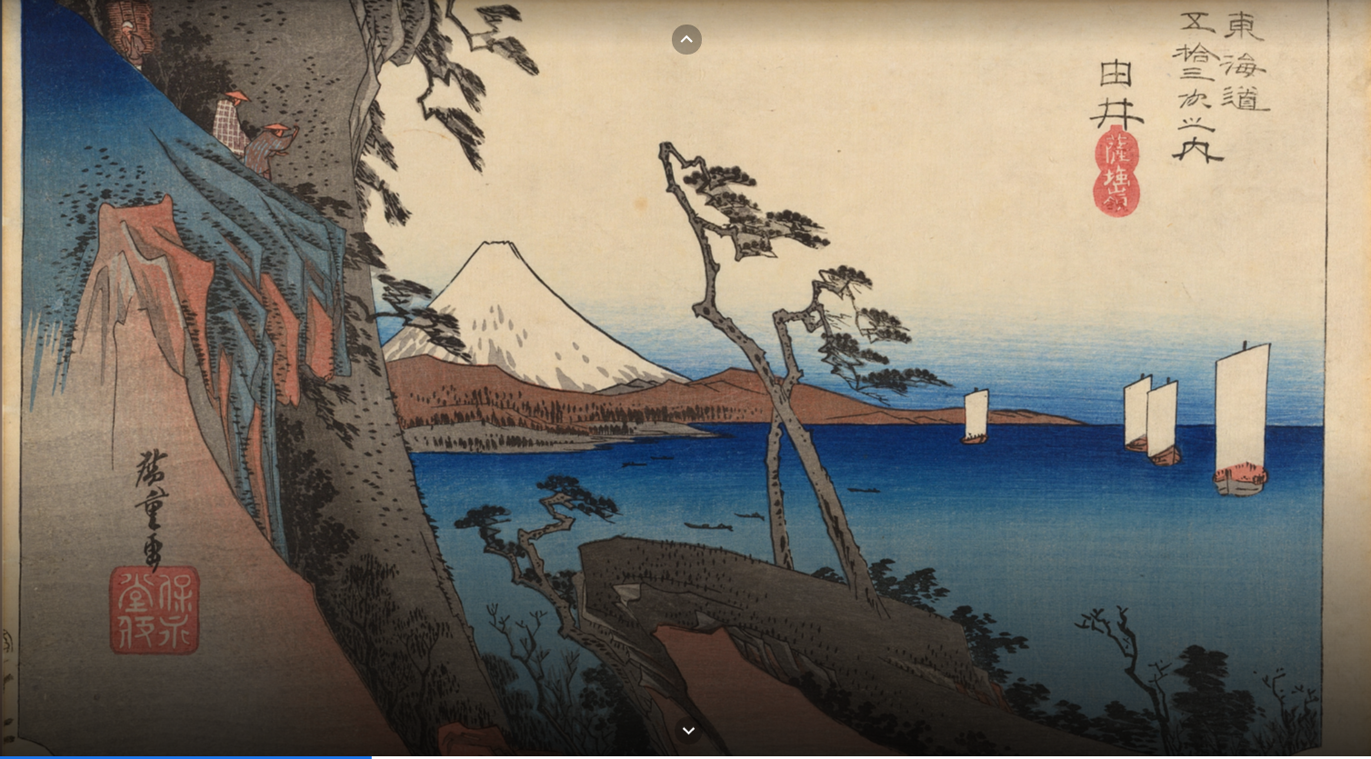
What are Ukiyo-e
Ukiyo-e
Ukiyo-e is a genre of Japanese art which flourished from the 17th through 19th centuries. Its artists produced woodblock prints and paintings of such subjects as landscapes.
The term ukiyo-e (浮世絵) translates as "picture[s] of the floating world"
The Great Wave of Kanagawa – Hatsushika Hokusai
Why Ukiyo-e
I found Japanese culture very fascinating, online I found no GAN that generates this kind of art from scratch, and I took my chance
The Satta Pass at Yui (Station #17) - Utagawa Hiroshige
Source: https://artsandculture.google.com/story/the-ukiyo-e-artists-you-need-to-know/BQKC6o0k2oBRLA
Marco Calamo 1808240

Slide 4
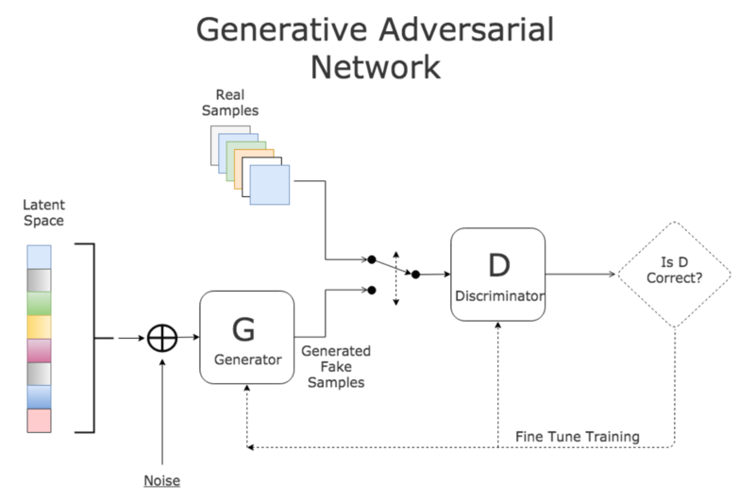
Generative Adversarial Network
What is a GAN
A generative adversarial network (GAN) is a class of machine learning frameworks designed by Ian Goodfellow and his colleagues in June 2014.[1]
GAN for image generation
The Generator takes in input a latent space vector (noise) and gets as output an image of the desired size
The Generator improves itself by using the results of the discriminator
The Discriminator takes in input real and fake images and tries to label them correctly
The Discriminator improves itself by checking the correctness of its classification
Marco Calamo 1808240

Slide 5
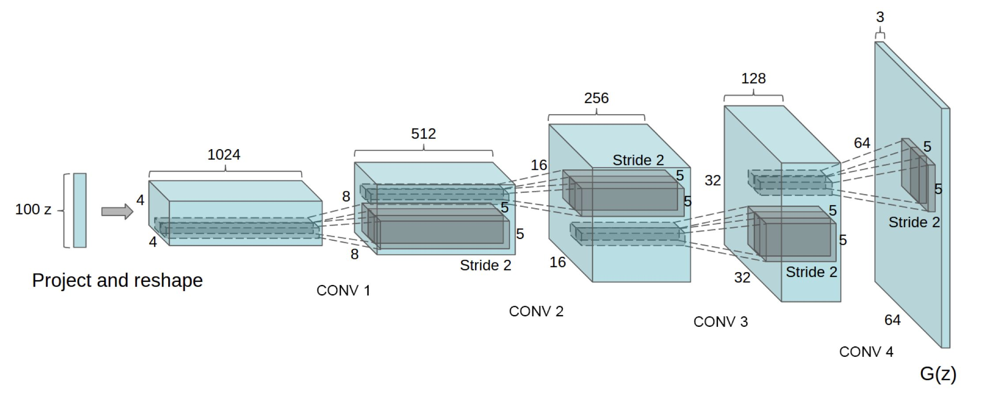
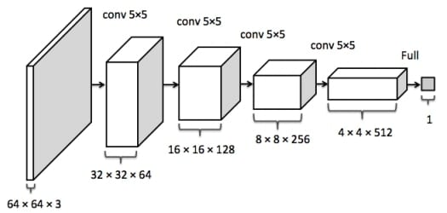
Deep Convolutional GAN
DCGAN
A deep convolutional generative adversarial network (DCGAN) using convolutional layers in order to be more detailed in image generation and more accurate in image disrimination.
It was first designed in 2016 and has become very popular nowdays.[2]
DCGAN generator
DCGAN in this project
DCGAN is used for generating new Ukiyo-e images from scratch, after having the model trained with the dataset.
DCGAN implementation
The base model is taken from 2016 paper, was slightly tweaked and implemented using Pytorch.
DCGAN discriminator
Marco Calamo 1808240

Slide 6
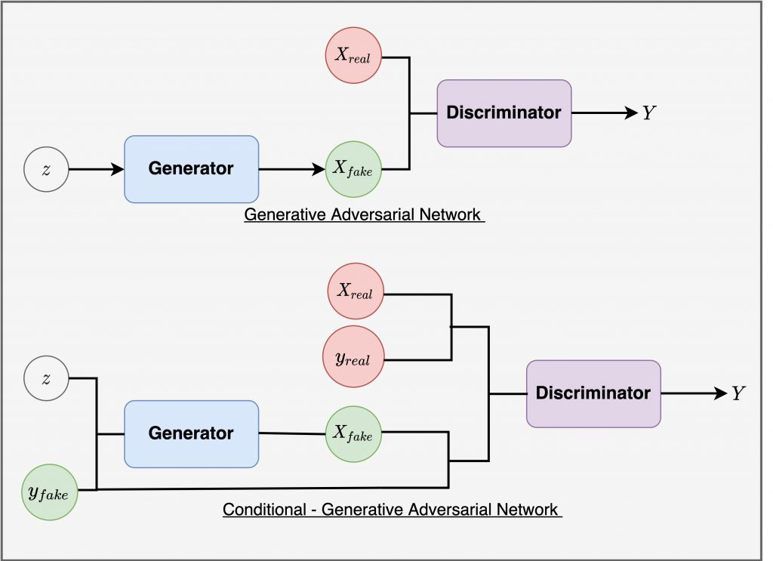
Condtional GAN
cGAN
A conditional convolutional generative adversarial network (cGAN) adds to the GAN the possibility to condtion generation and discrimniation with a value indicating the target class of the image. It is also possibile to use cGAN with convoultional layers. [3]
cGAN in this project
cGAN is used for generating new Ukiyo-e images from scratch with the style of a specified author from the dataet, after having the model trained.
cGAN implementation
The base model is taken from the paper, was slightly tweaked and implemented using Pytorch.
Marco Calamo 1808240

Slide 7
Dataset and Issues faced
Dataset
The Metropolitan Museum of Art Ukiyoe Dataset from Kaggle, counting 4043 high resoulution Ukiyo-e from 50 different authors, all exposed at New York's MET. [4]
Issues addressed
Issues still open
Image resolution
Adapting the model to my specific case
Data augmentation
Balanced Generator and Discriminator learining rate
Parameters Tweaking (learning rate, dropout percentages, label smoothing, epochs of training)
Too few images from too many authors
CGAN not produced the desired results, probably due to the lack of images in the dataset
Marco Calamo 1808240

Slide 8
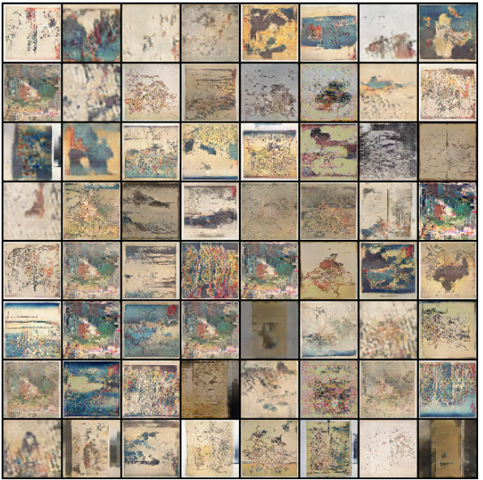
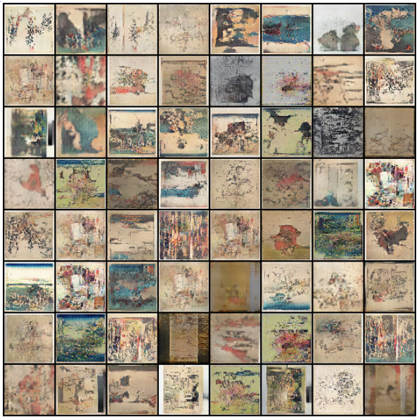
DCGAN Results
Images generated after 200 epochs
Images generated after 400 epochs
Marco Calamo 1808240

Slide 9
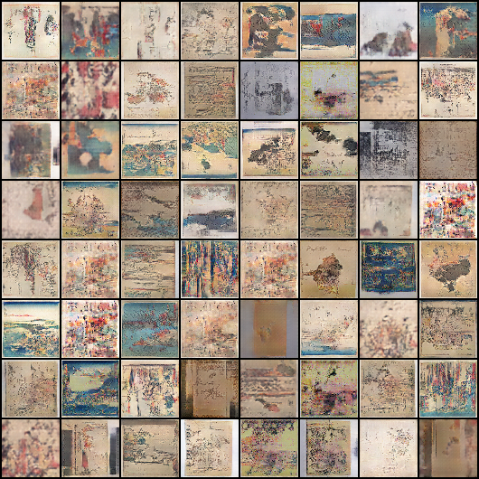
DCGAN Results
Images generated after 250 epochs
Marco Calamo 1808240

Slide 10
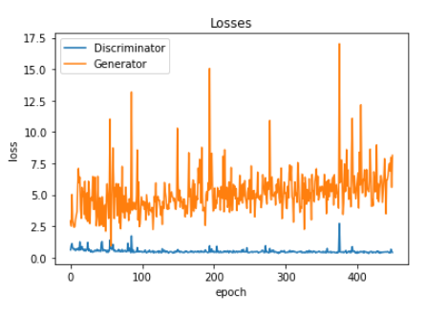
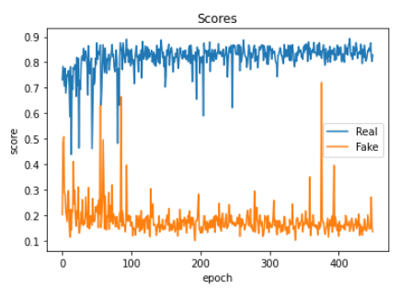
DCGAN Results
Discriminator and Generator loss among 450 epochs
Discriminator scores among 450 epochs
Marco Calamo 1808240

Slide 11
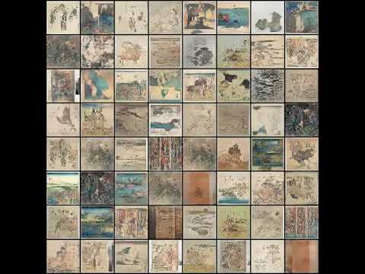
DCGAN Results
Marco Calamo 1808240

Slide 12
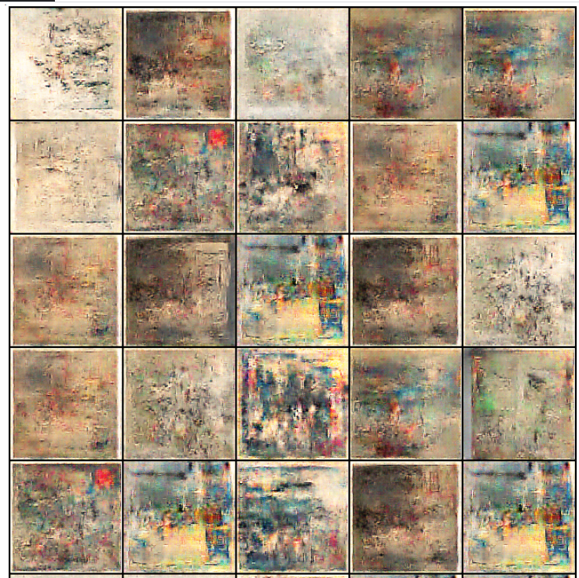
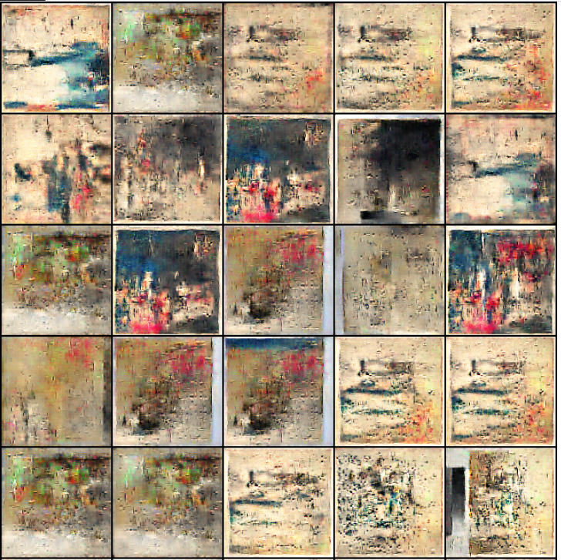
cGAN Results
Images generated after 200 epochs with randomized class output
Images generated after 400 epochs with randomized class output
Marco Calamo 1808240

Slide 13
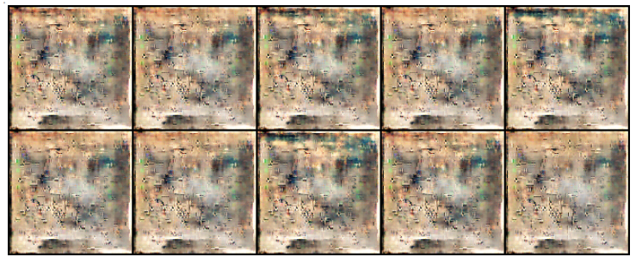
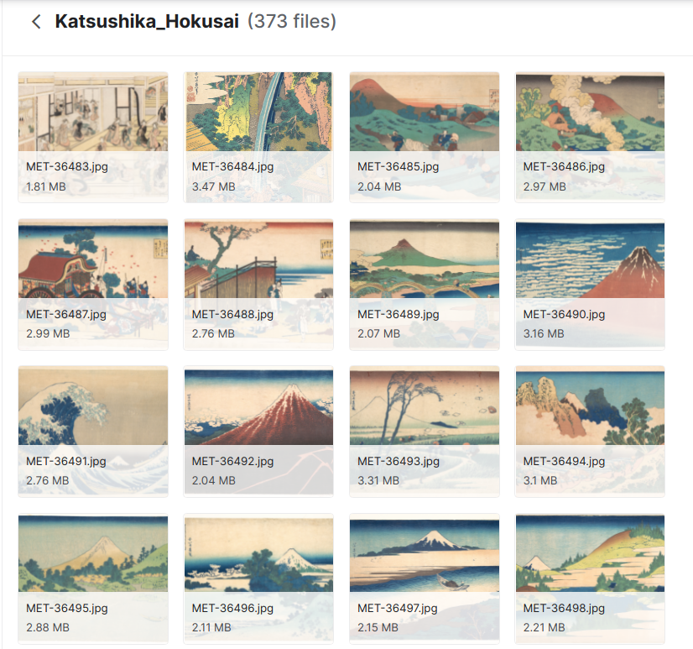
cGAN Results
Images generated after after 450 epochs with input as author Hokusai
Real images from dataset by Hokusai
Marco Calamo 1808240

Slide 14
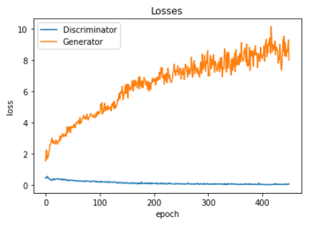
cGAN Results
Discriminator and Generator loss among 450 epochs
Marco Calamo 1808240

Slide 15
LIVE DEMO
Marco Calamo 1808240

Slide 16
Future Development
Take full advantage of Dataset:
High resolution output
Augment data in the most effective way
Develop a model that specifically targets this kind of image in order to obtain the most out of it, especially for cGAN, but the task is far from trivial
Marco Calamo 1808240

Slide 17
Bibliography
1: Generative Adversarial Nets
2: Unsupervised representation learning with Deep Convolutional Generative Adversarial Networks
3: Conditional Generative Adversarial Nets
4: Kaggle Ukiyo-e Dataset
Kaggle output
Github Repo (with all hw)
Marco Calamo 1808240

